Slide 1
Combinational Logic
Chapter 4b
Imran Siddiqi
imran.siddiqi@mcs.edu.pk
Computer Science Department
College of Telecommunication Engineering
National University of Sciences and Technology

Slide 2
Contents
Binary Addition
Half Adder
Full Adder
Implementation of full adder with two half adders
4 bit binary adder
Binary Adders/Subtractor
Handling overflow

Slide 3
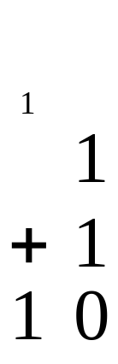
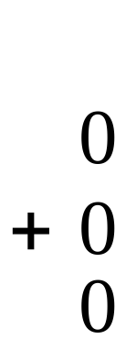
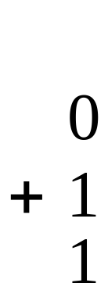
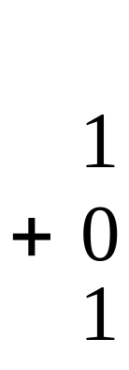
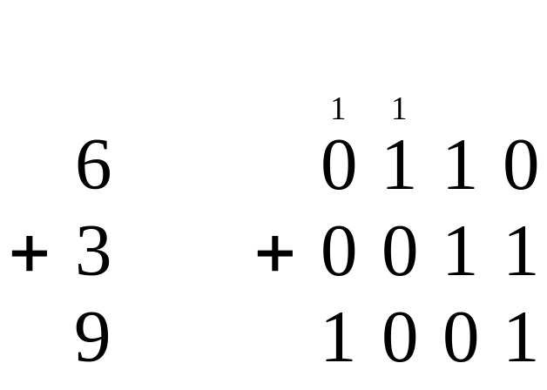
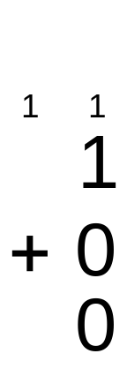
Binary Addition
Single Bit Addition:
Carry
Multiple Bit Addition:
C_{out}
C_{in}
A
B
Sum
Notes:
This slide shows the four possible combinations of adding together two single bit binary numbers and how these single bits can be cascaded into the addition of two 4-bit binary numbers. The 4-bit is just an example; we could have used 8-bits, 12-bits, etc.
XOR, XNOR, & Adders
Digital Electronics™
Lesson 2.4 – Specific Comb Circuit & Misc Topics
Project Lead The Way, Inc.
Copyright 2009

Slide 4
Two Types of Adders
Half Adder
Full Adder
2 Inputs (A & B)
2 Outputs (Sum & C_{out})
Used for LSB only
3 Inputs (A, B, C_{in})
2 Outputs (Sum & C_{out})
Used for all other bits
Half Adder
Full Adder
A
B
C_{in}
A
B
Sum
C_{out}
Sum
C_{out}
Notes:
Explain the two types of adders, half adder and full adder.
XOR, XNOR, & Adders
Digital Electronics™
Lesson 2.4 – Specific Comb Circuit & Misc Topics
Project Lead The Way, Inc.
Copyright 2009

Slide 5
Binary Adder-Subtractor
Most Basic arithmetic function is Addition of two binary digits
  0+0=0, 1+0=1, 0+1=1, 1+1=10 (Carry)
  Carry is added to the next higher order pair of significant values
A combinational circuit that performs addition of two bit is called Half Adder
A combinational circuit that performs addition of three bits is called Full Adder (Adding two half adder)
  Making slight changes the adder circuit can be used for subtraction

Slide 6
Half Adder
x | y | S (Sum) | C_{out} (Carry)
0 | 0 | 0 | 0
0 | 1 | 1 | 0
1 | 0 | 1 | 0
1 | 1 | 0 | 1
Half
Adder
S
x
y
C_{out}
S(A,B) | 0 | 1
0 | 0 | 1
1 | 1 | 0
C | 0 | 1
0 | 0 | 0
1 | 0 | 1
  S = x’y+xy’ C_{out} = xy

Slide 7
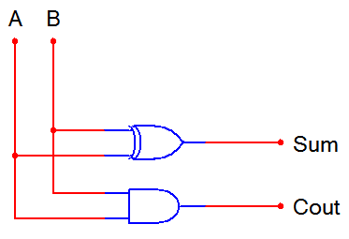
Half Adder
X
y
  S = x’y+xy’
  C_{out} = xy

Slide 8










Full Adder
A | B | C_{in} | Sum | C_{out}
0 | 0 | 0 | 0 | 0
0 | 0 | 1 | 1 | 0
0 | 1 | 0 | 1 | 0
0 | 1 | 1 | 0 | 1
1 | 0 | 0 | 1 | 0
1 | 0 | 1 | 0 | 1
1 | 1 | 0 | 0 | 1
1 | 1 | 1 | 1 | 1
 |  | V
 | 0 | 0
 | 0 | 1
 | 1 | 1
 | 0 | 1

Slide 9
Full Adder
A | B | C_{in} | Sum | C_{out}
0 | 0 | 0 | 0 | 0
0 | 0 | 1 | 1 | 0
0 | 1 | 0 | 1 | 0
0 | 1 | 1 | 0 | 1
1 | 0 | 0 | 1 | 0
1 | 0 | 1 | 0 | 1
1 | 1 | 0 | 0 | 1
1 | 1 | 1 | 1 | 1
 |  | V
 | 0 | 1
 | 1 | 0
 | 0 | 1
 | 1 | 0

Slide 10
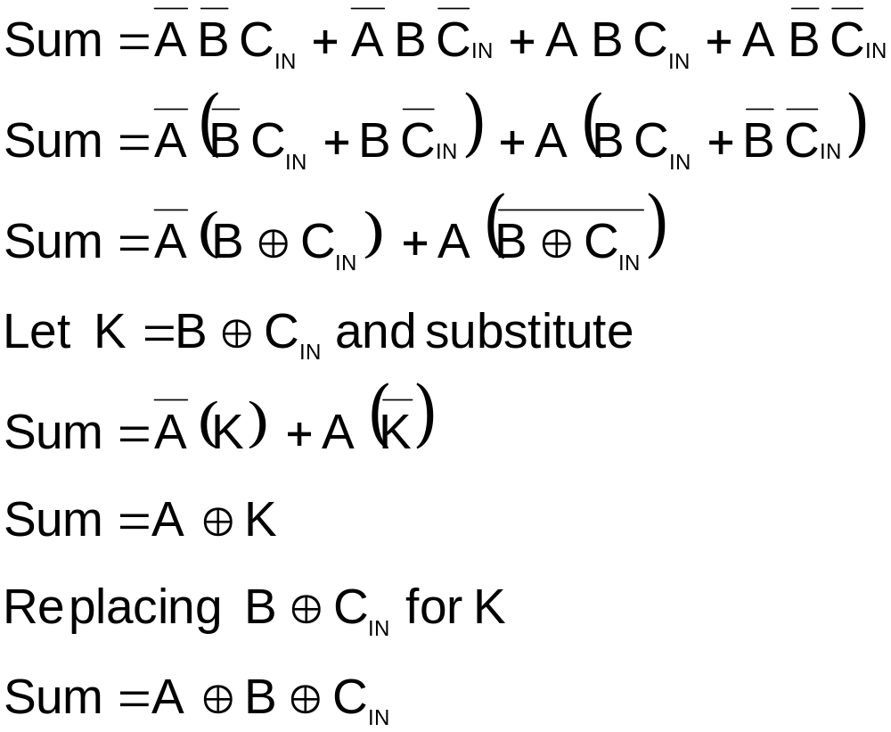
Full Adder

Slide 11
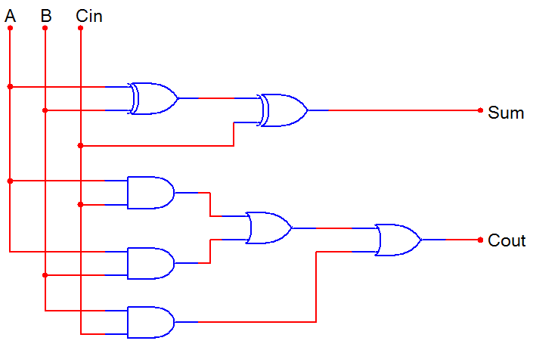
Full Adder

Slide 12
Full Adder
SSI - Full Adder

Slide 13
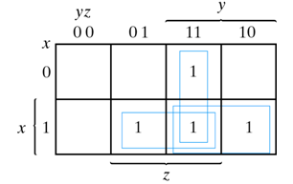
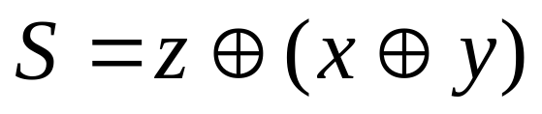

Full Adder – Implementation with Two Half Adders
z
Inputs
Outputs
x
y
z
S
C
Full
Adder
S
0
0
0
0
0
x
0
0
1
1
0
0
1
0
1
0
0
1
1
0
1
y
C
1
0
0
1
0
1
0
1
0
1
1
1
0
0
1
1
1
1
1
1

Slide 14
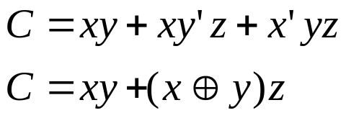
Full Adder – Implementation with Two Half Adders
z
Inputs
Outputs
x
y
z
S
C
Full
Adder
S
x
0
0
0
0
0
0
0
1
1
0
0
1
0
1
0
y
C
0
1
1
0
1
1
0
0
1
0
1
0
1
0
1
1
1
0
0
1
1
1
1
1
1

Slide 15
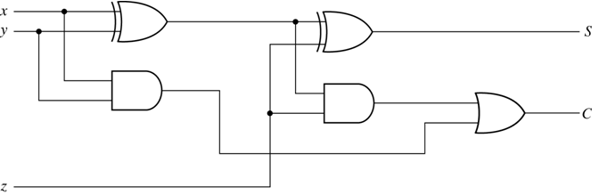
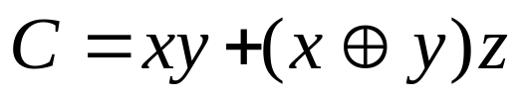
Full Adder – Implementation with Two Half Adders

Slide 16
Binary Adder
Binary Adder is a circuit that produces sum of two binary numbers
It can be constructed with full adders (FA) connected in cascade, with output carry from one connected to the input carry of the next full adder

Slide 17
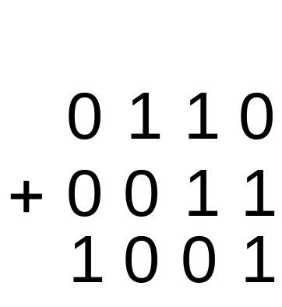
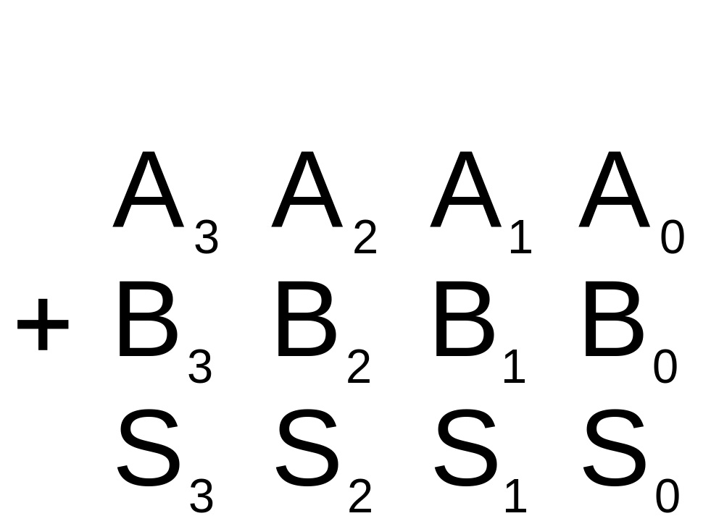
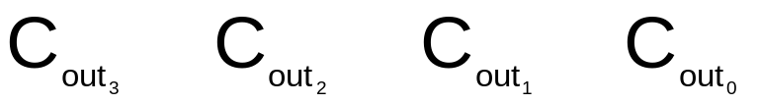
Cascading Adders – Four bits
Example: 6 + 3 = 9
General Form

Slide 18
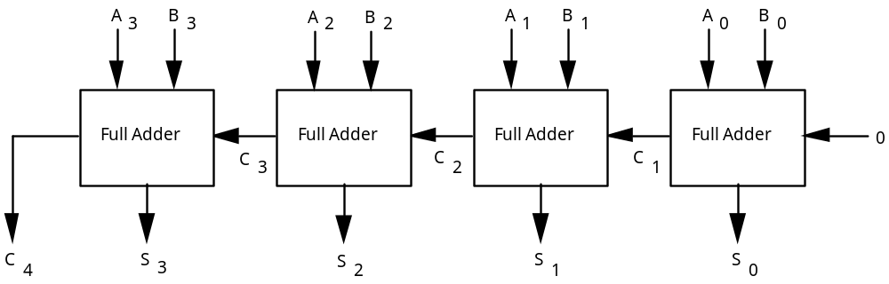
4-Bit Binary Adder
C 1 1 1 0
A 0 1 0 1
B 0 1 1 1
S 1 1 0 0

Slide 19
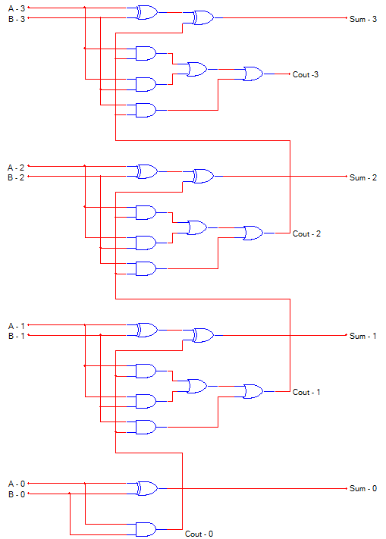
Full Adder
Full Adder
Full Adder
Half Adder

Slide 20
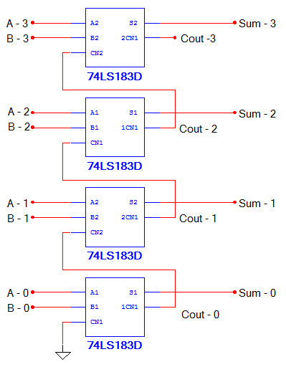
Full Adder
Full Adder
Full Adder
Full Adder

Slide 21
Binary Adder/Subtractor
The subtraction of unsigned binary numbers can be done by
complements.
Review complements:
1’s complement can be formed by changing 1’s to 0’s and 0’s to 1’s
2’s complement of a number is done by Taking the 1’s complement and adding 1 to the least significant bit in the number.

Slide 22
Binary Adder/Subtractor
How can we implement subtraction?
  Subtraction is addition of complement
  N – M = N + (two’s complement of M)
How do we determine 2’s complement?
  1’s complement (flip bits) and add 1
How can we flip bits?
  NOT gate (subtraction only)
  XOR gate (to provide control: Add/Sub):
    x ⊕ 0 = x (use for Add)
    x ⊕ 1 = x’ (use for Sub)
  How can we add 1?
    Input carry

Slide 23
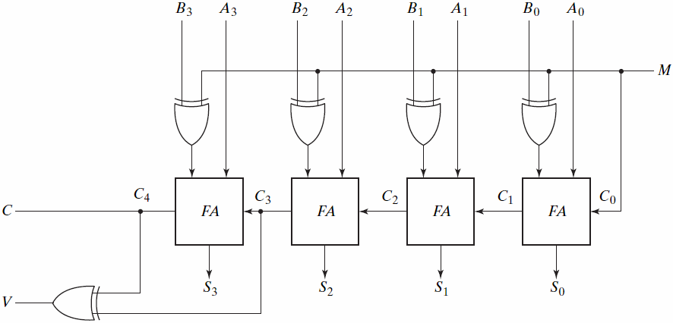
Binary Adder/Subtractor
Bit flip
Add1
M is used as a control and not as data input
M=0 Addition M=1 Subtraction
Over flow

Slide 24


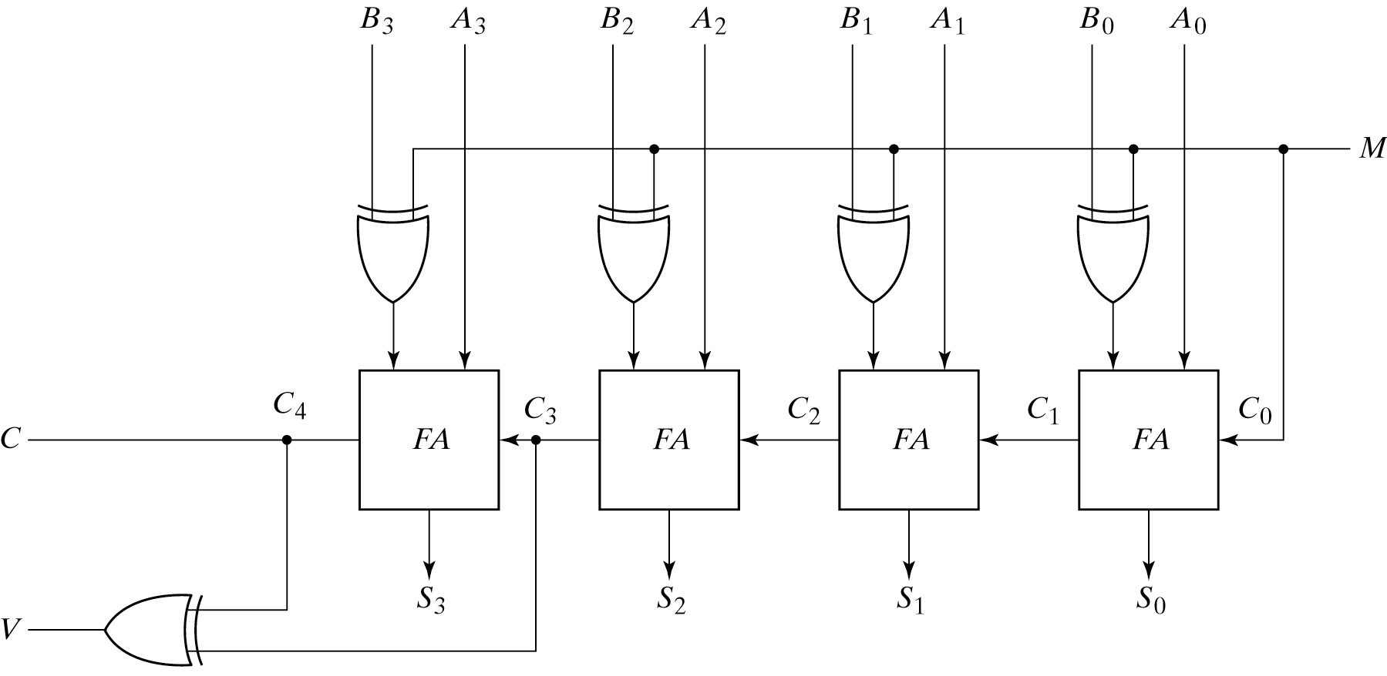
Binary Adder/Subtractor
Control M controls the the operation (addition or subtraction)
M = 0 → Adder: A plus B, C₀ = 0
M = 1 → Adder: A plus 2’s complement and a C₀ = 1 →A - B
M = 1:

Slide 25
Overflow
n-bit addition can generate (n+1)-bit number
  Resulting in “overflow”
  Problem: Needs to be detected by computer system
How can we detect overflow?
For unsigned numbers
  End carry out of most significant position
For signed numbers
  Most significant bit indicates sign
  If carry into sign position and out of sign position differ, then overflow
  Detected by XOR gate

Slide 26

Overflow
Overflow cannot occur if one number is positive and other is negative
1 | 1
 | 0 | 1 | 0 | 1 | 0 | 0 | 0 | 0
 | 1 | 0 | 1 | 1 | 1 | 0 | 1 | 0
 | 0 | 0 | 0 | 0 | 1 | 0 | 1 | 0
+ | 8 | 0
- | 7 | 0
+ | 1 | 0
8 bits can hold signed numbers: -128 to + 127
0 | 0
 | 0 | 1 | 0 | 0 | 0 | 1 | 1 | 0
 | 1 | 0 | 1 | 1 | 0 | 0 | 0 | 0
 | 1 | 1 | 1 | 1 | 0 | 1 | 1 | 0
+ | 7 | 0
- | 8 | 0
- | 1 | 0

Slide 27

Overflow
Overflow may occur both numbers are positive or both are negative
0 | 1
 | 0 | 1 | 0 | 0 | 0 | 1 | 1 | 0
 | 0 | 1 | 0 | 1 | 0 | 0 | 0 | 0
 | 1 | 0 | 0 | 1 | 0 | 1 | 1 | 0
 | + | 7 | 0
 | + | 8 | 0
+ | 1 | 5 | 0
8 bits can hold signed numbers: -128 to + 127
1 | 0
 | 1 | 0 | 1 | 1 | 1 | 0 | 1 | 0
 | 1 | 0 | 1 | 1 | 0 | 0 | 0 | 0
 | 0 | 1 | 1 | 0 | 1 | 0 | 1 | 0
 | - | 7 | 0
 | - | 8 | 0
- | 1 | 5 | 0

Slide 28
Overflow
1 | 1
 | 0 | 1 | 0 | 1 | 0 | 0 | 0 | 0
 | 1 | 0 | 1 | 1 | 1 | 0 | 1 | 0
 | 0 | 0 | 0 | 0 | 1 | 0 | 1 | 0
0 | 1
 | 0 | 1 | 0 | 0 | 0 | 1 | 1 | 0
 | 0 | 1 | 0 | 1 | 0 | 0 | 0 | 0
 | 1 | 0 | 0 | 1 | 0 | 1 | 1 | 0
0 | 0
 | 0 | 1 | 0 | 0 | 0 | 1 | 1 | 0
 | 1 | 0 | 1 | 1 | 0 | 0 | 0 | 0
 | 1 | 1 | 1 | 1 | 0 | 1 | 1 | 0
1 | 0
 | 1 | 0 | 1 | 1 | 1 | 0 | 1 | 0
 | 1 | 0 | 1 | 1 | 0 | 0 | 0 | 0
 | 0 | 1 | 1 | 0 | 1 | 0 | 1 | 0

Slide 29
Binary Adder/Subtractor
Bit flip
Add1
M is used as a control and not as data input
M=0 Addition M=1 Subtraction
Over flow

Slide 30
References
Chapter 4 – Digital Design Morris Mano
Logic and Computer Design Fundamentals, 4e, Power Point Slides, 2008 Pearson Education Inc.
Digital Design – Amirali Baniasadi
Material in these slides has been taken from, the following resources

